Slide 1

The Shell Prompt
General format: username@machinename, followed by the current working directory, and a dollar sign
If we have a hash (#) at the end, instead of the dollar, the user has superuser/root privileges

Slide 2
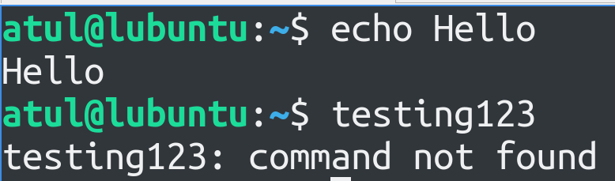
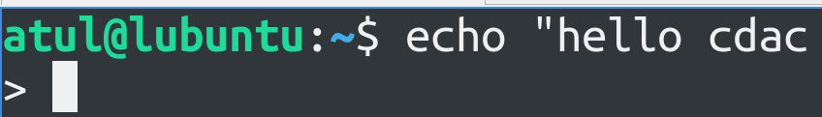
Valid and Invalid Commands
Valid commands: Valid output, Invalid commands: Error
Sometimes, we expect the command prompt to appear, but it does not
Example: Type “hello cdac and press ENTER
It thinks the command is not complete
Use either “ or Ctrl+C to complete/exit

Slide 3
The date Command
date: Display the system date
TZ='America/Los_Angeles' date: As per the specified time zone
Question: Display the system date in following format: Today is Friday, 17 May 96
date +“Today is %A, %d %B %y"
%A: Full weekday name (e.g., Monday, Tuesday)
%d: Day of the month (01 to 31)
%B: Full month name (e.g., January, February)
%y: Year without century (00 to 99)

Slide 4
Linux Command Format
command -option argument
Command: The name of the command we want to execute
Options: Change the default command behavior and start with a single hyphen or double hyphen, i.e. – or --
Single hyphen: Short form of the option, Double hyphen: Full option name
Arguments: Inputs to the command
Examples:
date -I … ISO format
date --iso … Same command, but using full form of the option
date -r /path/to/file … Last modification date and time for a file

Slide 5
Command Options: More Examples
sort -ru colors.txt
sort -r -u colors.txt
sort --reverse --unique colors.txt
All the above commands will give the same result

Slide 6
The Manual Page
Documentation/Help about commands/Linux in general
The man command
Example: man sort
Type q to exit

Slide 7
The which Command
Returns the executable file name for a command
Example: which clear

Slide 8
File and Directory Management

Slide 9
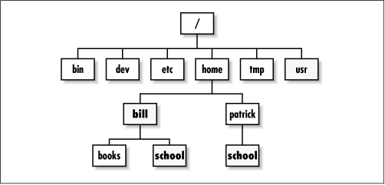
Directory Structure
/ is the root directory – Starting point for the file system
Each user on the system has a sub-directory inside home
The tilda symbol (~) represents the user’s home directory

Slide 10
Confusion!
Try this:
cd /
ls
This means go to the root directory and see directory listing
We see a directory named root! What is this?
Linux creates a default user called root (the superuser/administrator), who has its home directory named root under the actual top-level root directory, i.e. /

Slide 11
The home directory
The /home directory contains a sub-directory for each user on the system
Example: /home/dac, /home/dbda, /home/ditiss, /home/ai
The user dac’s home directory will be /home/dac, etc

Slide 12
Directory Shortcuts
/ Root directory (the very beginning of the file system)
~ Current user’s home directory (e.g. /home/dac)
. Current directory
.. Parent of the current directory

Slide 13
File and Directory Commands
touch: Create an empty file
pwd: Print Working Directory
cd: Change directory
Absolute path: Start from root – cd /home/atul/Downloads
Relative path: Start from current position – cd .. or cd test
Go to root: cd /
Go to user’s home directory: cd
Note: . is the current directory and .. Is the parent directory
ls: List all files in a specified directory
mkdir: Create a directory
cp: Copy files and directories
mv: Rename a file/directory
rm: Delete a file, rm -r: Recursively delete a directory and all sub-directories

Slide 14
Linux Processes
List all processes: ps
If we run the command again, we will again see the same two processes, but the PID for ps process would be different
To get help about all the options: ps --help all
Now try ps -e
The ps command shows processes for the current user only, but ps -e or ps -A shows all the processes running on the computer
top command: Shows dynamic list of processes and the resources they are consuming

Slide 15
Killing a Process
Reduce the terminal size of top command to half and open a second terminal in the second half
Note the pid of the top process
In the other terminal, try kill <pid>
This sends a SIGTERM to top process, killing it

Slide 16
Log Management
System log: Place where logs are generally maintained
One/Two services are used: systemd and journald
Command to run: journalctl
Important file: /etc/rsyslog.conf or /etc/syslog-ng
More log files: /var/log
Logs for a specific process: journalctl _PID=8792
Logs for the last four hours: journalctl -S -4h
Logs from a specific day/time: journalctl -S ‘2024-07-24 14:30:00’

Slide 17
Changing Password and Shell
Changing password: passwd command
Changing shell: chsh command

Slide 18
su and sudo Commands
Linux is very strict about what users can do
Ordinary users can work in their home directory and can perform operations related to their own work
Many Linux operations require elevated (higher) privileges: Two commands can be used for this
sudo: Superuser Do: Execute a command as the superuser – Own password is needed
Example: Update system package list: sudo apt update … apt = Advanced Package Tool
su: Switch User: Switch the current user to another user (If no name is specified, switch to root) – Target user’s password is required
Example: su - to switch to the root user and then exit to return to the previous user
On Ubuntu: su -i

Slide 19
/etc/sudoers File
Linux does not permit any user to run commands as superuser unless the privileged users are configured in /etc/sudoers file
Example: Give user1 and user2 the power to run any command as root
User_Alias ADMINS = user1, user2
ADMINS ALL = NOPASSWD: ALL
root ALL=(ALL) ALL
Define ADMINS alias with two users
ALL = NOPASSWD: means users in ADMINS alias can use sudo command as root, the second ALL means any command and the first ALL means any host
root ALL=(ALL) ALL means the superuser may also use sudo to run any command on any host, the extra (ALL) means the superuser can also run commands as any other user
Note: Use the visudo command to edit /etc/sudoers file – it also checks syntax errors after we save the file

Slide 20
Users
Create a new user: sudo adduser cdac
Delete a user: sudo deluser cdac (On some systems, userdel)

Slide 21
/etc/passwd File
This plaintext file maps user names to user ids
Example:
root:x:0:0:root:/root:/bin/bash
daemon:x:1:1:daemon:/usr/sbin:/usr/sbin/nologin
bin:x:2:2:bin:/bin:/usr/sbin/nologin
sys:x:3:3:sys:/dev:/usr/sbin/nologin
cdac:x:65534:65534:cdac:/home/cdac:/bin/bash
One line per user having seven fields separated by colons

Slide 22
/etc/passwd File
Field 1: User name
Field 2: User’s encrypted password (Actual password is in the shadow file, if it contains x)
Field 3: User ID (UID) – User’s representation in the kernel
Field 4: Group ID (GID) – Determines file permissions
Field 5: User’s real name
Field 6: User’s home directory
Field 7: User’s shell
Note: The superuser (root) always has UID and GID of 0

Slide 23
/etc/shadow File
Contains user authentication information such as encrypted passwords and password expiry information
Matches with /etc/passwd file
Users interact with the /etc/passwd file using the passwd command (to change the password) … Example: sudo passwd cdac
Other commands: chfn (Change name) and chsh (Change shell)

Slide 24
/etc/shadow File Example
username:$6$rounds=5000$randomsalt$hashedpassworddata:18000:0:99999:7::: Username
Encrypted password (or an indication if the account is locked)
$6$: SHA-512 is used (Others: $1$ = MD-5, $2y$ = Blowfish, $5$ = SHA-256)
Randomsalt: Salt value used
Hashedpassworddata: (Password + Salt) hashed using SHA-512
Last password change date
Minimum days before password change
Maximum days before password change
Password expiration warning period
Inactive period before the account is disabled
Account expiration date
Reserved field

